Slide 1
Functions In Python
Creating and Using Functions

Slide 2
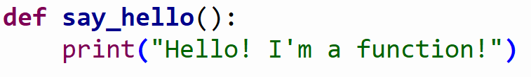
Functions in Python
Functions are blocks of code that are given a name so we can use them over and over again.
Functions start with keyword def, then the name, a pair of parenthesis ( ), and a colon
Code inside a function must be indendented

Slide 3
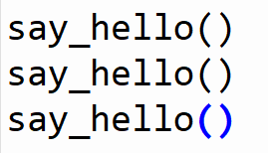
Functions in Python
To call a function like the one above from within the same module you wrote the function, simply type the name of the function – including the ()
Output:
Hello! I'm a function!
Hello! I'm a function!
Hello! I'm a function!

Slide 4
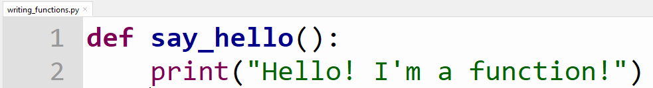
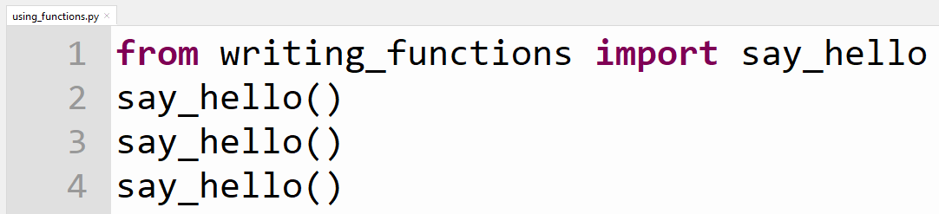
Functions in Python
To call a function from a different module we must import the function.
Here the say_hello function has been written in module named writing_functions
As long as the module using_functions is saved in the same directory as writing_functions, we can import and use the say_hello function.

Slide 5
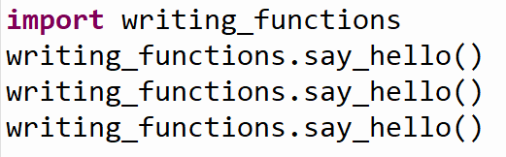
Functions in Python
To call a function from a different module we must import the function.
Instead of importing specific functions we can import an entire module. But we have to say the module name ‘dot’ before the function each time.

Slide 6
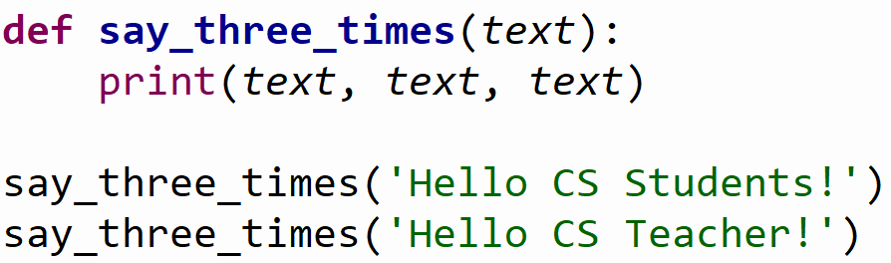
Functions in Python with Parameters
Functions can use parameters to allow customizing how they behave!
The variables in the () of the function def block are called parameters.
The values send are called arguments.
The parameters are like parking spaces waiting to be filled with values of the arguments.

Slide 7
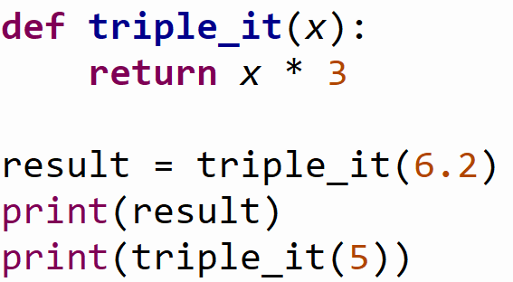
Functions in Python using the return keyword
Functions often make use of the return keyword.
return will send the information back to the spot that called the function in the program.
The value returned must either be stored in a variable or printed immediately.
Output:
18.6
15

Slide 8
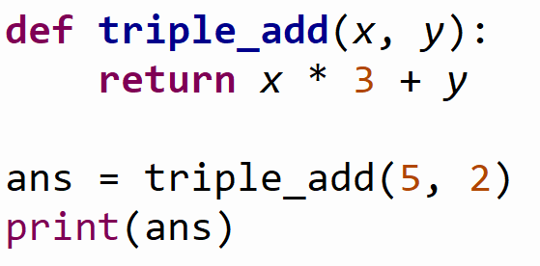
Functions in Python using Multiple Parameters
Functions can have as many parameters as necessary to get the work done.
Arguments fill the parameters in the order they are listed in the call statement.
Output:
17

